Slide 1

Entrepreneurship Development
By: Dr Kalpana Ambepitiya
Introduction
Chapter 01
Session 01

Slide 2
Introduction
Notes:
Change to 9th Edition and change title to Exploring Strategy. Update design

Slide 3
Chapter Objectives
Explain entrepreneurship and discuss its importance.
Describe corporate entrepreneurship and its use in established firms.
Discuss three main reasons that people become entrepreneurs.
Identify four main characteristics of successful entrepreneurs.
Explain the five common myths regarding entrepreneurs.
the economic impact of entrepreneurial firms.
Discuss the impact of entrepreneurial firms on society.
Identify ways in which large firms benefit from the presence of smaller entrepreneurial firms.
Explain the entrepreneurial process.

Slide 4
The Evolution of Entrepreneurship
Entrepreneur is derived from the French entreprendre, meaning “to undertake.”
  An entrepreneur is one who undertakes to organize, manage, and assume the risks of a business.

Slide 5
What is Entrepreneurship?
  A dynamic process of creating incremental wealth.
  This wealth is created by individuals who assume major risks in terms of equity, time, and/or career commitment of providing value for a product or service.
  The product or service itself may or may not be new or unique but the entrepreneur must somehow infuse value by securing and allocating the necessary skills and resources.
Notes:
5

Slide 6
What is Entrepreneurship?
  Entrepreneurship is the process by which individuals pursue opportunities without regard to the resources they currently control.
  The essence of entrepreneurial behavior is identifying opportunities and putting useful ideas into practice.
  The set of tasks called for by this behavior can be accomplished by either an individual or a group and typically requires creativity, drive, and a willingness to take risks.

Slide 7
What is Entrepreneurship?
eBay Case
Pierre Omidyar, the founder of eBay, exemplified all these qualities. Omidayar saw an opportunity to create a marketplace where people could find each other online. He risked his career by quitting his job to work on eBay full-time. He worked hard to build a profitable company that delivers customers a creative and useful service.

Slide 8
Entrepreneurs: Challenging the Unknown
Entrepreneurs
  Recognize opportunities where others see confusion or contradictions
  Are aggressive catalysts for change within the marketplace
  Challenge the unknown and continuously create the future

Slide 9
Entrepreneurship: A Mindset
Entrepreneurship is more than the mere creation of business:
  Seeking opportunities
  Taking risks beyond security
  Having the tenacity to push an idea through to reality
Entrepreneurship is an integrated concept that permeates an individual’s business in an innovative manner.
Notes:
9

Slide 10
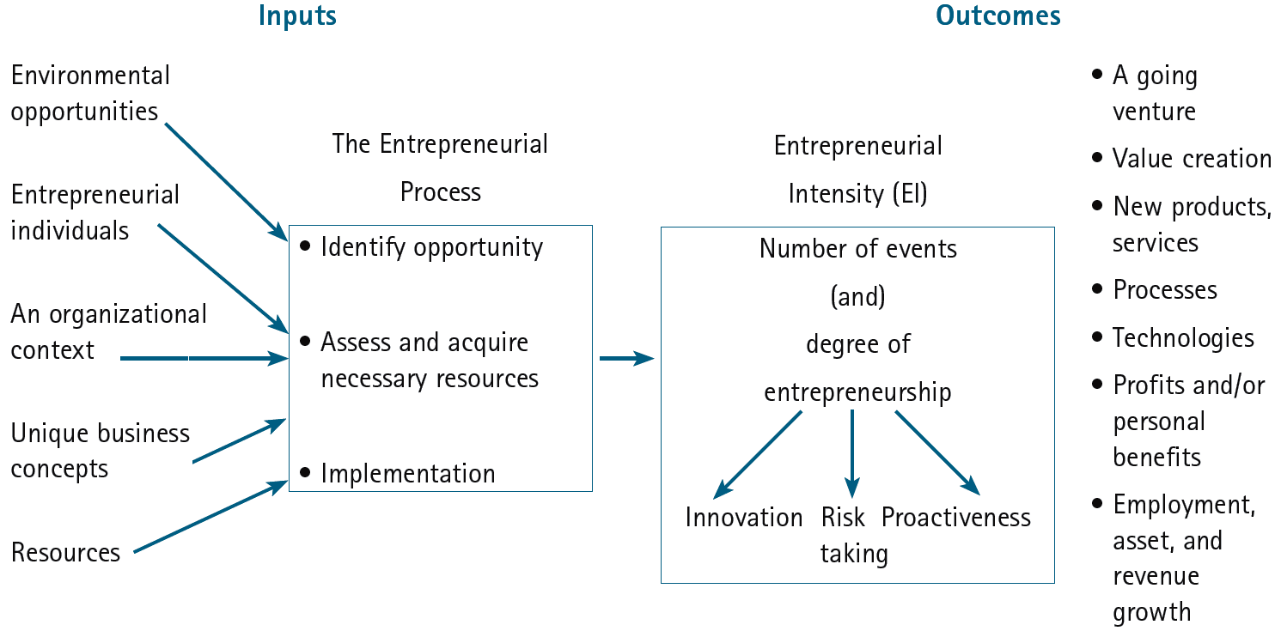
An Integrative Model of Entrepreneurial
Inputs and Outcomes
Source: Michael H. Morris, P. Lewis, and Donald L. Sexton, “Reconceptualizing Entrepreneurship: An Input-Output Perspective,” SAM Advanced Management Journal 59, no.1 (Winter 1994): 21–31.
Notes:
10

Slide 11

Difference Between an Inventor and an Entrepreneur
  An inventor creates something new.
  An entrepreneur puts together all the resources needed—the money, the people, the strategy, and the risk-bearing ability to transform the invention into a viable business.

Slide 12
What is Corporate Entrepreneurship?
  Is the conceptualization of entrepreneurship at the firm level.
  All firms fall along a conceptual continuum that ranges from highly conservative to highly entrepreneurial.
Entrepreneurial Firms
Conservative Firms
Proactive
Innovative
Risk taking
Take a more “wait and see”
posture
Less innovative
Risk adverse
Notes:
Integrated approach: if the operations are not in line with strategy then the the strategy will fail
Change : heritage and culture issue in mergers and acquistions

Slide 13


Why Become an Entrepreneur?
The three primary reasons that people become entrepreneurs and start their own firms
Desire to be their own boss
Desire to pursue their
own ideas
Financial rewards

Slide 14
Characteristics of Successful Entrepreneurs
Passion for the Business
The number one characteristic shared by successful entrepreneurs is a passion for the business.
This passion typically stems from the entrepreneur’s belief that the business will positively influence people’s lives.
Product/Customer Focus
A second defining characteristic of successful entrepreneurs is a product/customer focus.
Developing products that enhance people's lives is an aspect of the entrepreneurial process that many business owners find very rewarding.

Slide 15
Characteristics of Successful Entrepreneurs
Tenacity Despite Failure
Because entrepreneurs are typically trying something new, the failure rate is naturally high.
A defining characteristic of successful entrepreneurs is their ability to persevere through setbacks and failures.
Execution Intelligence
The ability to fashion a solid business idea into a viable business is a key characteristic of successful entrepreneurs.
The ability to translate thought, creativity, and imagination into action and measurable results is the essence of execution intelligence.

Slide 16
Common Myths About Entrepreneurs
Myth 1: Entrepreneurs Are Born Not Made
  This myth is based on the mistaken belief that some people are genetically predisposed to be entrepreneurs.
  The consensus of many studies is that no one is “born” to be an entrepreneur; everyone has the potential to become one.
  Whether someone does or doesn’t become an entrepreneur, is a function of the environment, life experiences, and personal choices.
  Although no one is “born” to be an entrepreneur, there are common personality traits and characteristics of successful entrepreneurs.

Slide 17
Common Myths About Entrepreneurs
Myth 2: Entrepreneurs Are Gamblers
  A second myth about entrepreneurs is that they are gamblers and take big risks. The truth is, most entrepreneurs are moderate risk-takers.
  The idea that entrepreneurs are gamblers originates from two sources:
    Entrepreneurs typically have less structured jobs, and so they face a more uncertain set of possibilities than people in traditional jobs.
    Many entrepreneurs have a strong need to achieve and set challenging goals, a behavior that is often equated with risk-taking.

Slide 18
Common Myths About Entrepreneurs
Myth 3: Entrepreneurs Are Motivated Primarily by Money.
  While it is naïve to think that entrepreneurs don’t seek financial rewards, money is rarely the reason entrepreneurs start new firms.
  Some entrepreneurs warn that the pursuit of money can be distracting.

Slide 19
Common Myths About Entrepreneurs
Myth 4: Entrepreneurs Should Be Young And Energetic.
  The average entrepreneur is 35 to 45 years old and has 10 or more years of experience in a large firm.
  While it is important to be energetic, investors often cite the strength of the entrepreneur as their most important criterion in making investment decisions.
  What makes an entrepreneur “strong” in the eyes of an investor is experience, maturity, a solid reputation, and a track record of success.
  These criteria often favor older rather than younger entrepreneurs.

Slide 20
Economic Impact of Entrepreneurial Firms
Innovation
Is the process of creating something new, which is central to the entrepreneurial process.
Small entrepreneurial firms are responsible for over two-thirds of all innovations in the U.S.
Job Creation
In the past two decades, economic activity has moved in the direction of smaller entrepreneurial firms, which may be due to their unique ability to innovate and focus on specialized tasks.

Slide 21
Economic Impact of Entrepreneurial Firms
Globalization
  Today, over 97% of all U.S. exporters are small businesses with fewer than 500 employees.
  According to the World Bank Enterprise Survey, exports represent about 6.2 and 11 percent of total sales of small and medium-scale enterprises, respectively in the manufacturing sector compared with 23 percent for large firms.
  The SME sector in Sri Lanka accounts for 52 percent of the GDP, and 45 percent of the total employment, whilst making up more than 75 percent of the total number of enterprises in the country.
  In Sri Lanka, there are 3,027 SMEs registered as exporters. However, they contribute to less than 5 percent of Sri Lanka’s exports.

Slide 22
Entrepreneurial Firms’ Impact on Society and Larger Firms
Impact on Society
The innovations of entrepreneurial firms have a dramatic impact on society.
Think of all the new products and services that make our lives easier, enhance our productivity at work, improve our health, and entertain us in new ways.
Impact on Larger Firms
Many entrepreneurial firms have built their entire business models around producing products and services that help larger firms become more efficient and effective.

Slide 23
The Entrepreneurial Process
Ideation
Planning/foundation
Launching and initial growth
Accelerating
Scaling and Upscaling
Consolidation and Sustainability
Exit / Long-term Growth

Slide 24
The End

